Slide 1
Corporate Tax in the UAE
Let’s begin the groundwork

Slide 2
Timelines
MoF press release on CT in the UAE and FAQs
The Law is published in the Official Gazette
Deadline to submit comments on PCD
The Law is made public
First tax year starts on and from this date
28 April
3 October
26 October
2023
2022
30 January
20 May
10 October
9 December
I June
Executive Regulations expected soon
MoF releases Public Consultation Document on CT
The Law comes into effect on this date
MoF releases the Federal Decree-Law on Taxation of Corporations and Businesses

Slide 3
Effective Date and Taxable Financial Year
Corporate Tax is proposed to be implemented from the financial year beginning on or after 1 June 2023
Corporate Tax Return is required to be filed on or before 9 months from the end of the financial year of taxable person
Examples
1
2
3
4
5
6
Financial Year | First Taxable Year | Due date for filing First CT Return
June to May | 1 June 2023 to 31 May 2024 | 28 February 2025
July to June | 1 July 2023 to 30 June 2024 | 31 March 2025
January to December | 1 January 2024 to 31 December 2024 | 30 September 2025
April to March | 1 April 2024 to 31 March 2025 | 31 December 2025
September to August | 1 September 2023 to 31 August 2024 | 31 May 2025
October to September | 1 October 2023 to 30 September 2024 | 30 June 2025

Slide 4
Transitional Rules
Opening Balance Sheet
The opening balance sheet for a Taxable Person shall be the closing balance sheet as prepared under the applicable accounting standards in the UAE.
1
2
3
4
5
6
Examples:
FY is January to December, then closing balance sheet will be as at 31 December 2023.
FY is April to March, then closing balance sheet will be as at 31 March 2024.
* The Minister may prescribe any conditions or adjustments to the opening balances

Slide 5
Transitional Rules
Applicable Accounting Standards
UAE largely accepts and follows IFRS
1
2
3
4
5
6
Article 27(3) of the Commercial Companies Law prescribes use of International Accounting Standards and Practices for preparing the periodical and annual accounts.
Section 6.2 of the Companies Regulations of DIFC specifies the companies to follow IFRS.
ADGM requires individual and group accounts to be prepared in accordance with International Accounting Standards.
JAFZA specifies accounts must be prepared in accordance with applicable accounting principles or standards

Slide 6
Transitional Rules
Arm’s Length Principle
The opening balances with respect to Related Parties and Connected Persons, if any, MUST consider the arm’s length principle.
1
2
3
4
5
6
Transitional Rules imply that all transactions with Related Parties and Connected Persons during the immediate previous year MUST be as per the Transfer Pricing Policy
Bhavya will discuss on Transfer Pricing Policy

Slide 7
Transitional Rules
General Anti-Abuse Rules
GAAR is an anti-tax avoidance provisions
“Transaction” or “Arrangement” entered with a motive to obtain corporate tax benefit
1
2
3
4
5
6
If it cannot be otherwise demonstrated, FTA has the right under the Law to make suitable adjustments and levy tax on such income.
The following needs to be considered:
the manner in which it was carried out
the form and substance
the timing
the result
any change or expected change in the financial position of Taxable Person or the Other Person.
created any rights or obligations which is outside the arm’s length principle

Slide 8
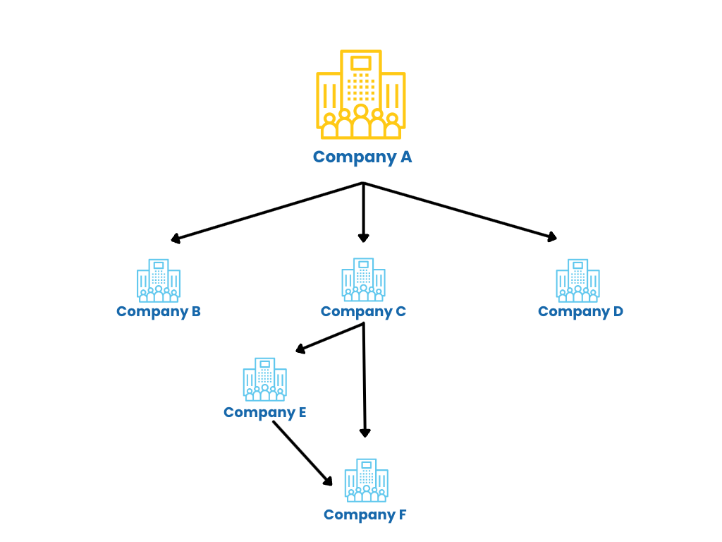
What You MUST do now
While we await the Executive Regulations, we suggest taxpayers to start the groundwork for implementation of corporate tax
Review the corporate structure
1
2
3
4
5
6
Why is this required?
One: to understand the ownership structure of the companies in the group
Two: to understand the flow of transactions within the group companies from the Related Parties angle

Slide 9
What You MUST do now
While we await the Executive Regulations, we suggest taxpayers to start the groundwork for implementation of corporate tax
Review the corporate structure
Identify and review the Income stream
Income or sales from:
Related Parties and third parties
Local sales and Exports
Exempt Income as per Article 22
For FZ companies, identify qualifying income and other income
Reconcile the income between Income Statement and VAT Reports (if not already doing)
Remember FTA is the authority for both VAT and CT

Slide 10
What You MUST do now
While we await the Executive Regulations, we suggest taxpayers to start the groundwork for implementation of corporate tax
Review the corporate structure
Identify and review the Income stream
1
2
3
4
5
6
Identify and review the expenses
Chapter 9 of the CT law deals with deductions
Deductible
Non-deductible
With limited allowance

Slide 11
What You MUST do now
While we await the Executive Regulations, we suggest taxpayers to start the groundwork for implementation of corporate tax
Review the corporate structure
Deductibles
Identify and review the Income stream
1
2
3
4
5
6
Identify and review the expenses
Chapter 9 of the CT law deals with deductions
Deductible
Expenditure directly incurred for the purpose of business or generating taxable revenue
Non-deductible
With limited allowance

Slide 12
What You MUST do now
While we await the Executive Regulations, we suggest taxpayers to start the groundwork for implementation of corporate tax
Review the corporate structure
Non-deductibles
Identify and review the Income stream
1
2
3
4
5
6
Identify and review the expenses
Chapter 9 of the CT law deals with deductions
Deductible
Non-business or Personal nature
Fines and penalties
Bribes
Dividends
WHT (non allowed portion)
Donations to non-qualifying public benefit entity
Expenditure incurred on earning exempt income
Non-deductible
With limited allowance

Slide 13
What You MUST do now
While we await the Executive Regulations, we suggest taxpayers to start the groundwork for implementation of corporate tax
Review the corporate structure
With limited allowance
Identify and review the Income stream
1
2
3
4
5
6
Identify and review the expenses
Chapter 9 of the CT law deals with deductions
Deductible
Interest
Entertainment expense
Non-deductible
With limited allowance

Slide 14
What You MUST do now
While we await the Executive Regulations, we suggest taxpayers to start the groundwork for implementation of corporate tax
Review the corporate structure
Identify and review the Income stream
1
2
3
4
5
6
Identify and review the expenses
Relook and update the chart of accounts and accounting system

Slide 15
What You MUST do now
While we await the Executive Regulations, we suggest taxpayers to start the groundwork for implementation of corporate tax
Review the corporate structure
Identify and review the Income stream
1
2
3
4
5
6
Tax Group
Identify and review the expenses
Relook and update the chart of accounts and accounting system
Analyse the benefits of Group registration viz.a.viz. standalone
UAE Parent Company directly or indirectly owns at least 95% in the subs
All companies follow the same FY and GAAP
None should be Exempt of Qualifying FZP
Tax Group will be treated as single Taxable Person

Slide 16
What You MUST do now
While we await the Executive Regulations, we suggest taxpayers to start the groundwork for implementation of corporate tax
Review the corporate structure
Identify and review the Income stream
1
2
3
4
5
6
Identify and review the expenses
Relook and update the chart of accounts and accounting system
Analyse the benefits of Group registration viz.a.viz. standalone
Training to relevant staff

